Slide 1
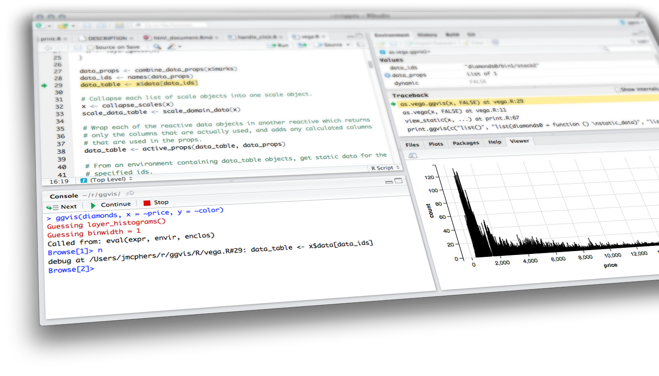

reactive programming
& Understanding UI
Shiny from

Slide 2
Reactive Programming Part 1
Reactivity 101
Reactive objects
Reactive sources and endpoints
Reactive conductors
Implementation
Observers and side effects
Render functions
Understanding UI
Ladder of Progression
High Level View
Shiny built-ins
External packages
HTML Tools
RAW HTML

Slide 3
reactive programming
Part 1
Shiny from

Slide 4
Reactivity
101

Slide 5
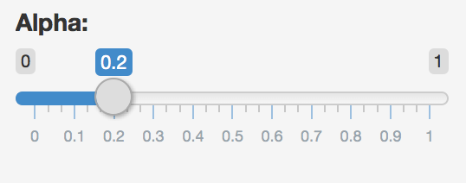
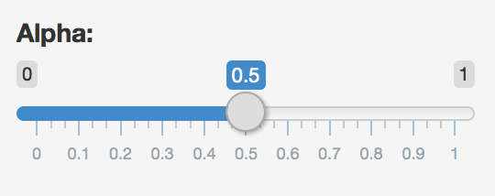
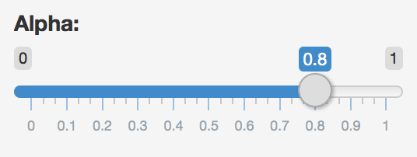
Reactions
The input$ list stores the current value of each input object under its name.
input$alpha = 0.2
# Set alpha level
sliderInput(inputId = "alpha",
label = "Alpha:",
min = 0, max = 1,
value = 0.5)
input$alpha = 0.5
input$alpha
input$alpha = 0.8
Notes:
Sliding the slider will change the value assigned to input$alpha (animations)

Slide 6
reactivity 101
Reactivity automatically occurs when an input value
is used to render an output object
# Define server function required to create the scatterplot
server <- function(input, output) {
# Create the scatterplot object the plotOutput function is expecting
output$scatterplot <- renderPlot(
ggplot(data = movies, aes_string(x = input$x, y = input$y,
color = input$z)) +
geom_point(alpha = input$alpha)
)
}
Notes:
… which will then be used to set the alpha level of the points in the scatterplot

Slide 7

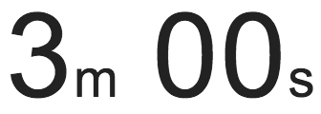
exercise
Go back to the app you built last class
Add a new sliderInput defining the size of points (ranging from 0 to 5)
Use this variable in the geom of the ggplot function as the size argument
Run the app to ensure that point sizes react when you move the slider
Compare your code / output with the person sitting next to / nearby you
Shiny from

Slide 8
Solution
Solution to the previous exercise
movies_06.R
Shiny from

Slide 9
Reactive
objects

Slide 10
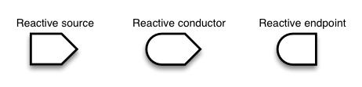
types of reactive objects

Slide 11
Reactive sources
and endpoints

Slide 12

sources and endpoints
Reactive source: Typically, this is user input that comes through a browser interface
Reactive endpoint: Something that appears in the user’s browser window, such as a plot or a table of values
This is the built-in reactivity discussed in the previous section
A reactive source can be connected to multiple endpoints, and vice versa

Slide 13
Reactive conductors

Slide 14
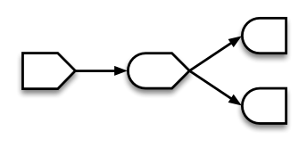
conductors
Reactive counductor: Reactive component between a source and an endpoint
A conductor can both be a dependent (child) and have dependents (parent)
Sources can only be parents (they can have dependents)
Endpoints can only be children (they can be dependents)

Slide 15
demo
Suppose you want the option to plot only certain types of movies as well as report how many such movies are plotted:
Add a UI element for the user to select which type(s) of movies they want to plot
Filter for chosen title type and save as a new (reactive) expression
Use new data frame (which is reactive) for plotting
Use new data frame (which is reactive) also for reporting number of observations
Shiny from

Slide 16
demo
Add a UI element for the user to select which type(s) of movies they want to plot
# Select which types of movies to plot
checkboxGroupInput(inputId = "selected_type",
label = "Select movie type(s):",
choices = c("Documentary", "Feature Film", "TV Movie"),
selected = "Feature Film")
Shiny from
Notes:
Solution to the previous exercise

Slide 17
demo
Filter for chosen title type and save the new data frame as a reactive expression
before app:
library(dplyr)
server:
Creates a cached expression that knows it is out of date when input changes
# Create a subset of data filtering for chosen title types
movies_subset <- reactive({
req(input$selected_type)
filter(movies, title_type %in% input$selected_type)
})
Shiny from
Notes:
Solution to the previous exercise

Slide 18
demo
Use new data frame (which is reactive) for plotting
# Create the scatterplot object the plotOutput function is expecting
output$scatterplot <- renderPlot({
ggplot(data = movies_subset(), aes_string(x = input$x, y = input$y,
color = input$z)) +
geom_point(…) +
…
})
Cached - only re-run when inputs change
Shiny from
Notes:
Solution to the previous exercise

Slide 19
demo
Use new data frame (which is reactive) also for printing number of observations
ui:
server:
mainPanel(
…
# Print number of obs plotted
uiOutput(outputId = "n"),
…
)
# Print number of movies plotted
output$n <- renderUI({
types <- movies_subset()$title_type %>%
factor(levels = input$selected_type)
counts <- table(types)
HTML(paste("There are",
counts,
input$selected_type,
"movies in this dataset.
<br>"))
})
Shiny from
Notes:
Solution to the previous exercise

Slide 20
demo
Putting it all together…
movies_07.R
(also notice the HTML tags,
added for visual separation, in the mainPanel)
Shiny from
Notes:
Putting it all together…

Slide 21
when to use reactives
By using a reactive expression for the subsetted data frame, we were able to get away with subsetting once and then using the result twice
In general, reactive conductors let you
not repeat yourself (i.e. avoid copy-and-paste code) which is a maintenance boon)
decompose large, complex (code-wise, not necessarily CPU-wise) calculations into smaller pieces to make them more understandable
These benefits are similar to what happens when you decompose a large complex R script into a series of small functions that build on each other

Slide 22
exercise
For consistency, in movies_07.R, there should be at least one more spot on the app where the new movies_subset dataset should be used, instead of the full movies dataset
Hint: Does the data table match the plotted data?
Find and fix
Run the app to confirm your fix is working
Compare your code / output with the person sitting next to / nearby you
Shiny from

Slide 23
Solution
Solution to the previous exercise
movies_08.R
Shiny from

Slide 24
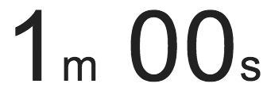
exercise
Suppose we want to plot only a random sample of movies, of size determined by the user. What is wrong with the following?
ui:
# Select sample size
numericInput("n_samp", "Sample size:", min = 1, max = nrow(movies), value = nrow(movies))
server:
# Create a new data frame that is a sample of n_samp observations from movies
movies_sample <- sample_n(movies, input$n_samp)
# Plot the sampled movies
output$scatterplot <- ggplot(data = movies_sample,
aes_string(x = input$x, y = input$y, color = input$z)) +
geom_point(…)
Shiny from

Slide 25
Solution
Solution can also be found in movies_09.R.
Note that output$n and output$datatable are also updated in the script.
ui:
# Select sample size
numericInput("n_samp", "Sample size:", min = 1, max = nrow(movies), value = 50)
server:
# Create a new data frame that is n_samp observations from selected type movies
movies_sample <- reactive({
req(input$n_samp) # ensure availablity of value before proceeding
sample_n(movies_subset(), input$n_samp)
})
# Plot the sampled movies
output$scatterplot <- renderPlot({
ggplot(data = movies_sample(), aes_string(x = input$x, y = input$y, color = input$z)) +
geom_point(…)
})
Shiny from

Slide 26
Implementation

Slide 27
implementation of reactive objects
Reactive values – reactiveValues():implementation of reactive sources
e.g. input object is a reactive value, which looks like a list, and contains many individual reactive values that are set by input from the web browser
Reactive expressions – reactive(): implementation of reactive conductors
Can access reactive values or other reactive expressions, and they return a value
Useful for caching the results of any procedure that happens in response to user input
e.g. reactive data frame subsets we created earlier
Observers – observe(): implementation of reactive endpoints
Can access reactive sources and reactive expressions, but they don’t return a value; they are used for their side effects
e.g. output object is a reactive observer, which also looks like a list, and contains many individual reactive observers that are created by using reactive values and expressions in reactive functions

Slide 28
Reactivity only works with reactive objects
Only reactive primitives (like the ones on the previous slide) and things built on top of reactive primitives, will elicit reactivity. In particular, do NOT expect changes to "normal" variables to cause reactivity.
x <- 10
y <- reactive({ x })
# Much later...
x <- 20
👎

Slide 29
Reactive Values
Like an R environment object (or what other languages call a hash table or dictionary), but reactive
Like the input object, but not read-only
rv <- reactiveValues(x = 10)
rv$x <- 20
rv$y <- mtcars

Slide 30
Reactive Values
Reading a value from a reactiveValues object is a reactive operation.
The act of reading it means the current reactive conductor or endpoint will be notified the next time the value changes.
Maybe surprisingly, setting/updating a value on a reactiveValues object is not in itself a reactive operation, meaning no relationship is established between the current reactive conductor or endpoint (if any!) and the reactiveValues object.

Slide 31
Observers and side effects

Slide 32
exercise
Suppose we want the user to provide a title for the plot. What is wrong with the following, and how would you fix it? See movies_10.R.
ui:
textInput(inputId = "plot_title",
label = "Plot title",
placeholder = "Enter text to be used as plot title"),
server:
output$pretty_plot_title <- toTitleCase(input$plot_title)
output$scatterplot <- renderPlot({
ggplot(data = movies_sample(), aes_string(x = input$x, y = input$y, color = input$z)) +
geom_point(alpha = input$alpha, size = input$size) +
labs(title = output$pretty_plot_title)
})
Shiny from

Slide 33
Solution
Observers do not have dependencies, use reactives instead. Solution can also be found in movies_11.R.
ui:
textInput(inputId = "plot_title",
label = "Plot title",
placeholder = "Enter text to be used as plot title"),
server:
pretty_plot_title <- reactive({ toTitleCase(input$plot_title) })
output$scatterplot <- renderPlot({
ggplot(data = movies_sample(), aes_string(x = input$x, y = input$y, color = input$z)) +
geom_point(alpha = input$alpha, size = input$size) +
labs(title = pretty_plot_title())
})
Shiny from

Slide 34
reactive expressions Vs. observers
Similarities: Both store expressions that can be executed
Differences:
Reactive expressions return values, but observers don’t
Observers (and endpoints in general) eagerly respond to reactives, but reactive expressions (and conductors in general) do not
Reactive expressions must not have side effects, while observers are only useful for their side effects

Slide 35
demo
We cheated earlier, let’s make it right with an observer!
See movies_12.R.
server <- function(input, output, session) {
...
# Update the maximum allowed n_samp for selected type movies
observe({
updateNumericInput(session, inputId = "n_samp",
value = min(50, nrow(movies_subset()))
)
})
...
}
Shiny from

Slide 36
Render
functions

Slide 37
Render functions
render*({ [code_chunk] })
Provide a code chunk that describes how an output should be populated
The output will update in response to changes in any reactive values or reactive expressions that are used in the code chunk

Slide 38
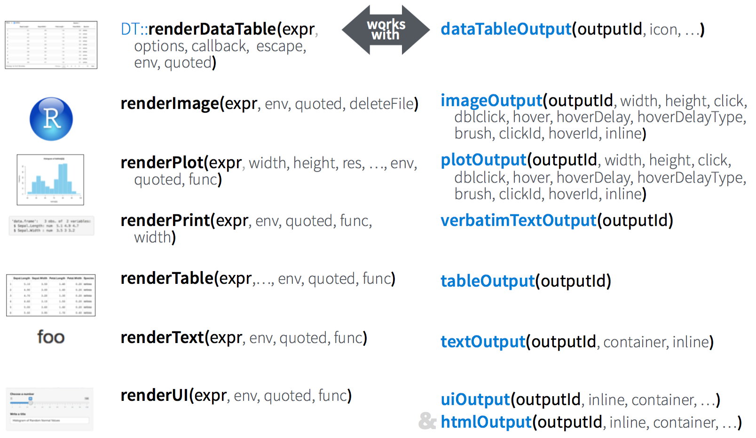
list of reactive functions

Slide 39
Recap
render*({ [code_chunk] })
These functions make objects to display
Results should always be saved to output$
They make an observer object that has a block of code associated with it
The object will rerun the entire code block to update itself whenever it is invalidated

Slide 40
exercise
Run the app in movies_12.R.
Try entering a few different plot titles and observe that the plot title updates however the sampled data that is being plotted does not.
Given that the renderPlot() function reruns each time input$plot_title changes, why does the sample stay the same?
Shiny from

Slide 41
Solution
Because the data frame that is used in the plot is defined as a reactive expression with a code chunk that does not depend on input$plot_title.
Shiny from

Slide 42
Class Break
Shiny from

Slide 43
Understanding UI
Shiny from

Slide 44
Web application UI is ultimately HTML/CSS/JavaScript
Shiny allows R users write user interfaces using a simple, familiar-looking API…
…but no limits for advanced users

Slide 45
Ladder of
progression

Slide 46
Ladder of UI Progression
Step 1. Shiny built-in inputs/outputs and layouts (sidebarLayout, navbarPage, tabsetPanel)
Step 2. Use functions from external packages (shinythemes, shinydashboard, shinybs)
Step 3. Use tag objects, write UI functions
Step 4. Author HTML templates
Step 5. Create custom inputs/outputs, wrap existing CSS/JS libraries and frameworks
Our focus today

Slide 47
High level
view

Slide 48
Multiple levels of abstraction
High-level funcs
fluidRow(...)
htmltools tags
div(class="row", ...)
Raw HTML markup
<div class="row">...</div>

Slide 49
Mix and Match Freely
High-level funcs
fluidRow(...)
htmltools tags
div(class="row", ...)
Raw HTML markup
<div class="row">...</div>

Slide 50
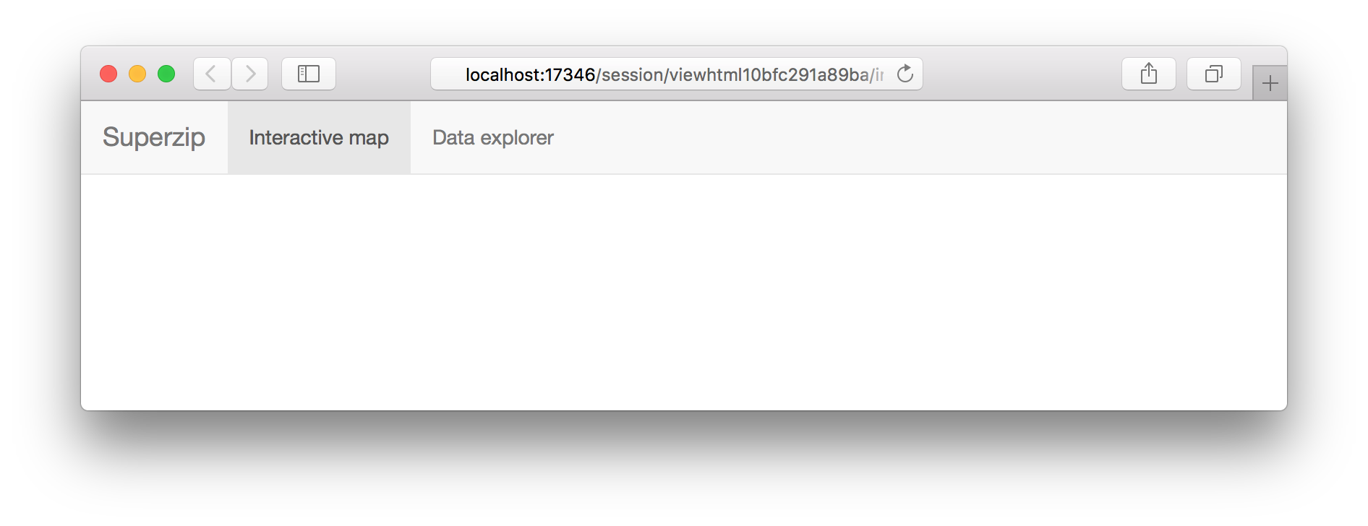

Slide 51
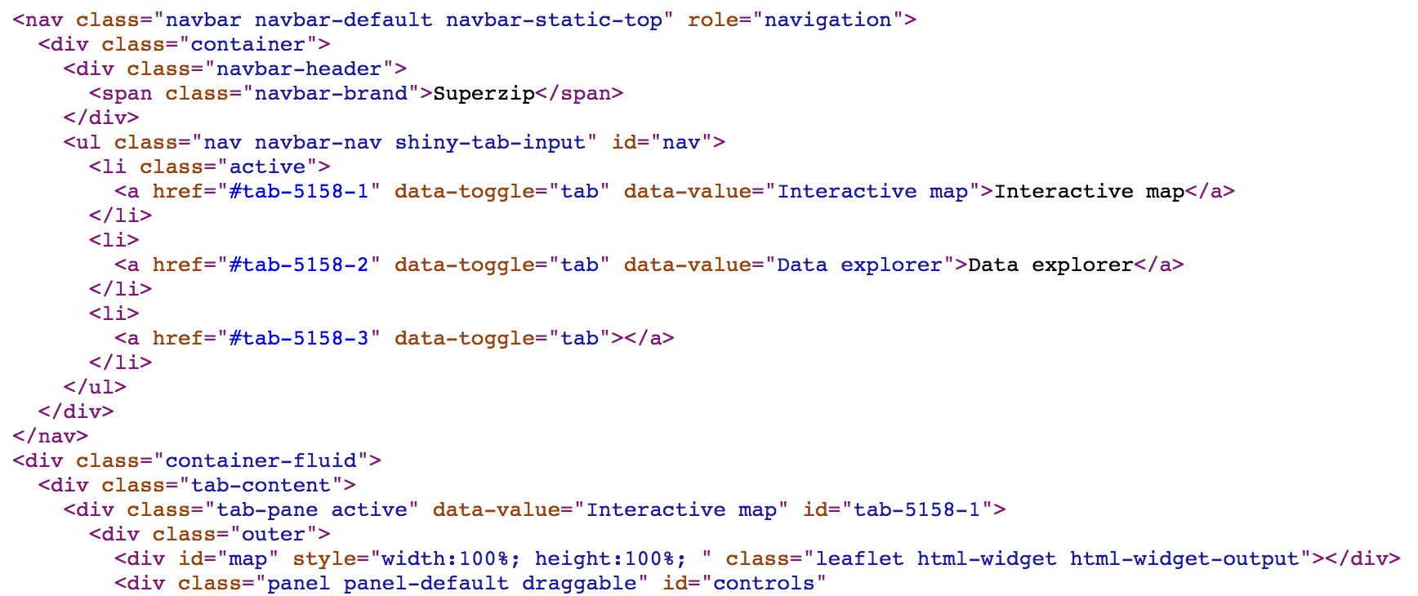
Raw HTML
Pros
Can do anything that's possible in a web page
Comfortable for designers, web developers
Cons
Unfamiliar for many R users
Potentially lots of HTML needed for conceptually simple tasks
CSS/JavaScript dependencies must be handled manually

Slide 52
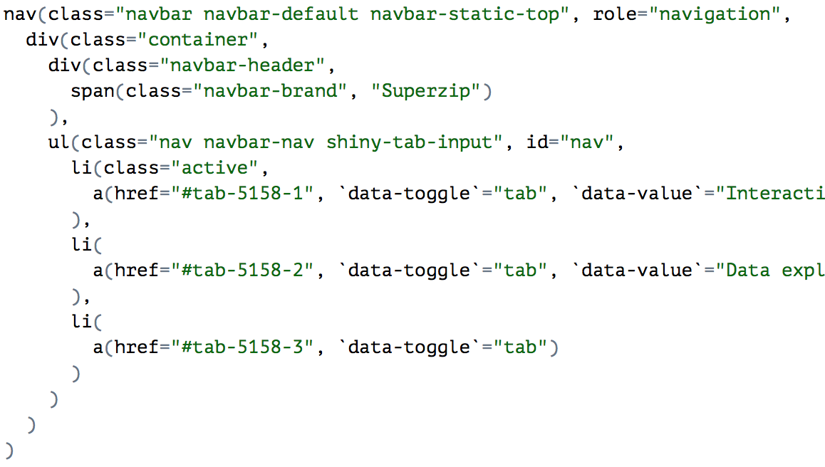
htmltools Objects
HTML-generating R functions
Pros
All the power of HTML, but looks like R
Automated CSS/JS dependency handling
More composable, programmable than HTML
Cons
Easy to misplace commas
Almost as verbose as raw HTML

Slide 53
High Level Functions
Functions that return htmltools objects
Pros
Less code, clearer intent
Anyone can make their own
Cons
Still have to watch out for commas
Less flexible
navbarPage("Superzip", id = "nav",
tabPanel("Interactive map", ...),
tabPanel("Data explorer", ...)
)

Slide 54
Using Shiny
built-ins
Notes:
The goal of this section is just to make sure you're familiar with the kinds of facilities Shiny offers you right out of the box. Move beyond the familiar sidebar layout with Bootstrap grids.

Slide 55
Shiny UI Built-ins
Bootstrap grid framework – fluidPage, fixedPage, fluidRow, column
Containers – wellPanel, absolutePanel, fixedPanel
Navigation panels – tabsetPanel, navlistPanel, navbarPage
Fill layouts (Shiny 0.13+) – fillPage, fillRow, fillCol
Modals and notifications (Shiny 0.14+) – showModal, modalDialog

Slide 56
Bootstrap Grid Framework
Every page has 12 invisible columns
Each column of content must span an integral number of columns
Simple R API for implementing Bootstrap grid
fluidPage(...) wraps the entire page
fluidRow(...) wraps each row's column
column(width, ...) wraps each column's content

Slide 57
Shiny from
© 2016 RStudio, Inc. All rights reserved.

Slide 58
Fluid Page
ui <- fluidPage(
fluidRow(
column(8, item1),
column(4, item2, item3),
),
fluidRow(
column(3, item4),
column(3, item5),
column(3, item6),
column(3, item7)
)
)

Slide 59
exercise
Modify ui_01.R to display the two outputs next to each other (instead of above and below)
Assign the left output to be 5 columns wide, and the right output to be 7 columns wide
See what happens as you change the width of the browser window
Shiny from
© 2016 RStudio, Inc. All rights reserved.

Slide 60
Solution
Solution to the previous exercise
ui_02.R
Shiny from
© 2016 RStudio, Inc. All rights reserved.

Slide 61
demo
Layouts https://shiny.rstudio.com/gallery/
Shiny from
© 2016 RStudio, Inc. All rights reserved.

Slide 62
Using external
packages
Notes:
Now I'll quickly show you some of the capabilities you can easily get using external packages like shinythemes, shinydashboard, shinybs, shinytoastr.

Slide 63
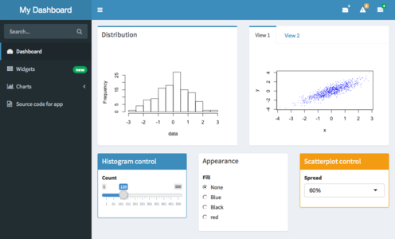
External Packages
shinydashboard

Slide 64
External Packages
shinydashboard
shinythemes

Slide 65
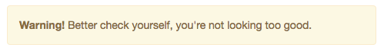
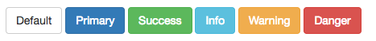
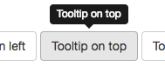
External Packages
shinydashboard
shinythemes
shinyBS (@ebailey78)

Slide 66
External Packages
shinydashboard
shinythemes
shinyBS (@ebailey78)
shinytoastr (@gaborcsardi)

Slide 67
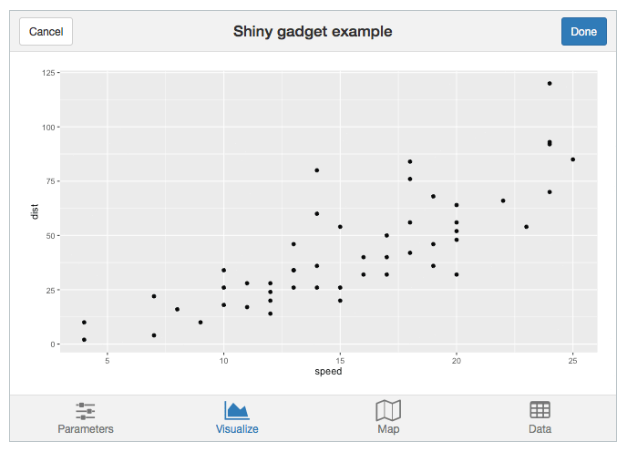
External Packages
shinydashboard
shinythemes
shinyBS (@ebailey78)
shinytoastr (@gaborcsardi)
miniUI (for mobile devices or Shiny Gadgets)

Slide 68
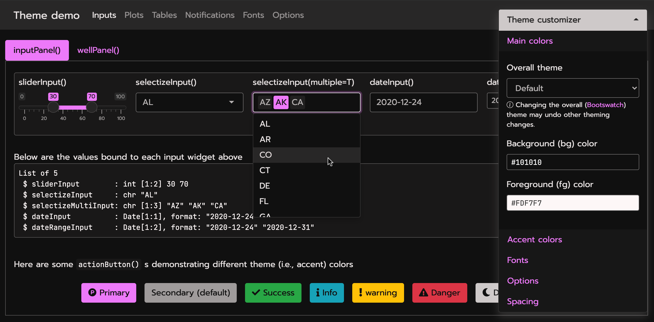
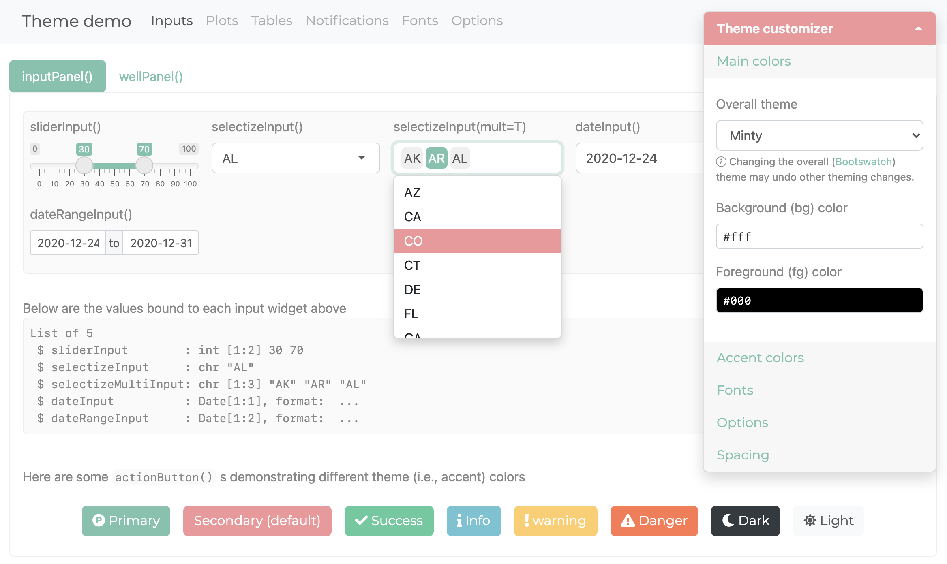
External Packages
bslib: https://github.com/rstudio/bslib
Demo: https://testing-apps.shinyapps.io/themer-demo/

Slide 69
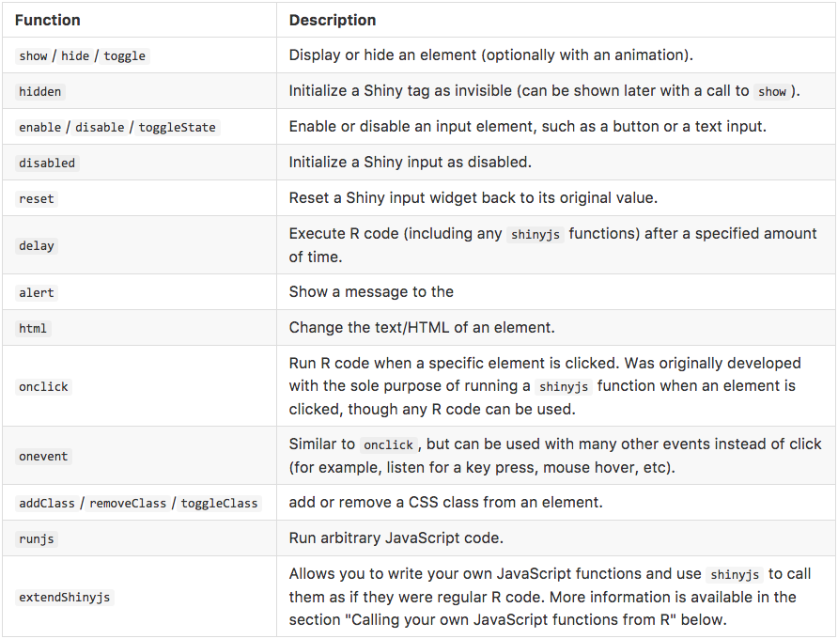
External Packages
shinyjs (@daattali)
Perform many UI-related JavaScript operations from R

Slide 70
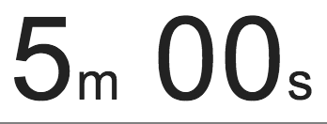
exercise
Modify movies_12.R to use a Bootstrap theme
Use the "Live theme selector" feature in shinythemes in your own app
Once you've decided on a theme, remove the theme selector and apply your chosen theme permanently
See shinythemes instructions at: https://rstudio.github.io/shinythemes/
Shiny from
© 2016 RStudio, Inc. All rights reserved.

Slide 71
Solution
Solution to the previous exercise
movies_13.R
Shiny from
© 2016 RStudio, Inc. All rights reserved.

Slide 72
Using htmltools
tag objects
Notes:
Now we get to the tag objects that power Shiny UI.
Show some custom Bootstrap HTML that isn't in Shiny
Reproduce this layout in htmltools
Use this code to create a reusable function

Slide 73
An API for Composing HTML
When Shiny was born, it came with a sub-package for composing HTML
These functions were so useful, we extracted them out into a separate package: htmltools
Now used by R Markdown and htmlwidgets as well

Slide 74
HTML Basics
<a href="https://www.posit.co">Posit</a>
Posit

Slide 75
HTML Basics
<a href="https://www.posit.co">Posit</a>
End tag
Child content
Start tag

Slide 76
Anatomy of a Tag
Attribute name
<a href="https://posit.co/">Posit</a>
Tag name
Attribute value
Creates an anchor whose hyperlink reference is the URL https://www.posit.co

Slide 77
Anatomy of a Tag
Text can contain tags
Tags can optionally contain text and/or other tags
Each start tag can have zero or more attributes

Slide 78
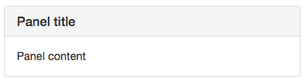
HTML to Browser UI
<div class="panel panel-default">
<div class="panel-heading">
<h3 class="panel-title">Panel title</h3>
</div>
<div class="panel-body">
Panel content
</div>
</div>

Slide 79
Looks like R, Means HTML
<div class="panel panel-default">
<div class="panel-heading">
<h3 class="panel-title">
Panel title
</h3>
</div>
<div class="panel-body">
Panel content
</div>
</div>
div(class="panel panel-default",
div(class="panel-heading",
h3(class="panel-title",
"Panel title",
)
),
div(class="panel-body",
"Panel content"
)
)

Slide 80
Using Tag Functions
Many common tags are exported as functions by htmltools and shiny (p, h1-h6, a, br, div, span, img)
All other tags can be accessed via the tags object. E.g., <li>Item 1</li> → tags$li("Item 1")
If you have lots of HTML to write, you can use the withTags function—it makes the tags$ prefix optional. withTags( ul( li("Item 1"), li("Item 2") ) )

Slide 81
Using Tag Functions
All tag functions behave the same way
Call the function to create a tag object
Named arguments become attributes
Unnamed arguments become children

Slide 82
Tag attributes
Any valid HTML attribute name can be used (use quotes if the name has dashes, e.g. "data-toggle"="dropdown")
Valid tag attribute values are:
NULL (omit the attribute)
NA (the attribute should be included with no value)
Single-element character vector (or something to be coerced to character)
tags$input(type = "checkbox", disabled = if (disabled) NA # else NULL )

Slide 83
Tag Children
Valid tag children are:
Tag objects
Single-element character vectors (treated as text)
NULL (silently ignored)
Raw HTML (see ?htmltools::HTML)
Lists of valid tag children (recursive!)

Slide 84
Using Tags
Tags are made using normal R functions that take normal parameters and return normal values! You can do R-like things to them: tags$ul(lapply(1:10, tags$li))
Print tag objects at the console to see their HTML source
Call print(x, browse = TRUE) to see their rendered view instead
Use htmltools::browsable() to make an object show its rendered view when printed, by default
If your top-level object is a list, you'll need to wrap in tagList(...) to get the right behavior at the console (or in an R Markdown doc)

Slide 85
exercise
Open ui_03.R.
Replace includeHTML("youtube_thumbnail.html") with the equivalent htmltools tag objects.
Hint: Take a look inside youtube_thumbnail.html.
If you get that working, take the next step and define an R function that takes a YouTube URL, a title, and a description, and returns a thumbnail frame like the one you created.
Shiny from
© 2016 RStudio, Inc. All rights reserved.

Slide 86
Solution
Solutions to the previous exercise
ui_04.R
ui_05.R
Shiny from
© 2016 RStudio, Inc. All rights reserved.

Slide 87
Using
raw HTML

Slide 88
Using raw HTML
Incorporate tiny amounts of HTML using inline string literals wrapped in HTML()
div(HTML("This is <strong>HTML</strong>"))
For chunks of (static) HTML, use includeHTML (or similar includeCSS, includeScript)
div(includeHTML("file.html"))
Or go the other way, with the HTML Templates feature: start with HTML, and embed R expressions that yield tag objects

Slide 89
Using
Shiny UI Editor

Slide 90
Shiny UI Live Demo

Slide 91
reactive programming
& Understanding UI
Shiny from

Slide 92
exercise
Create a new Repository in the Course GitHub organization (New>Enter your CMU ID+hw1 as the name>Set to Public (optional)>Create Repository)
On the new page click the green “Code” button and copy the HTTPS link
In RStudio create a new project (File > New Project > Version Control > Git)
For the Repository Link paste the URL you copied from your GitHub repository.
Click “Create Project”
Shiny from

Slide 93
exercise
GitHub Desktop Alternative
Create a new Repository in the Course GitHub organization (New>Enter your CMU ID+hw1 as the name>Set to Public (optional)>Create Repository)
On the new page click the green “Code” button and then “Open in GitHub Desktop”
In RStudio create a new project (File > New Project > Existing Directory)
For the Directory select the folder GitHub desktop cloned your repository to.
Click “Create Project”
Shiny from

Slide 94
exercise
Publishing a Shiny App
Sign up on https://www.shinyapps.io/
Go to the tokens page
Copy your tokens with secret to clip board
In Rstudio in any of the movies apps, go to the publish button
Follow the steps to add your shiny apps io token.
Publish the app
Shiny from

Slide 95

Homework
Homework 1
Shiny from

